Slide 1
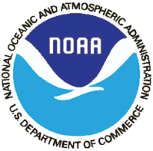
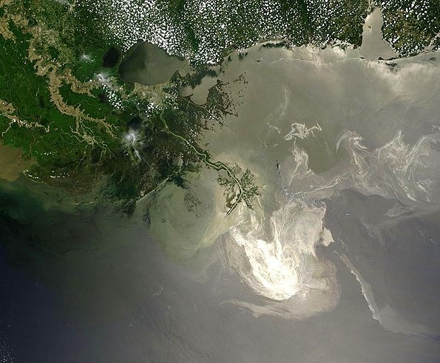
SPATIAL ASSESSMENT OF THE GULF OF MEXICO & CORAL REEF FISHERIES WITH AN EMPHASIS ON THE 2010 DEEPWATER HORIZON OIL SPILL
Patrina Bly
Educational Partnership Program Elizabeth City State University, Elizabeth City, North Carolina DOC/NOAA/NMFS/SEFSC MENTOR: Carlos Rivero
Notes:
Spatial Assessment of the Gulf of Mexico & Coral Reef Fisheries with an Emphasis on the 2010 Deepwater Horizon Oil Spill
Good Morning my name is Patrina Bly. I am a soon to be senior at Elizabeth City State University located in Elizabeth City, NC, “not Hampton as stated in your programs” and during the summer I had the privileged to work with the NMFS Southeast Fishery Science Center located in Miami, Florida, where I was provided with the opportunity to do some work as it pertains to the current situation unfolding in the Gulf of Mexico.

Slide 2
Outline
Deepwater Horizon
Objective/Background Information
Methodology
GIS Components/Application
Conclusion
Future Applications
Acknowledgments
Questions
Notes:
This is my outline, which is pretty basic in structure, however instead of starting off with my Objective I would first like to talk directly about the Deepwater Horizon incident.

Slide 3
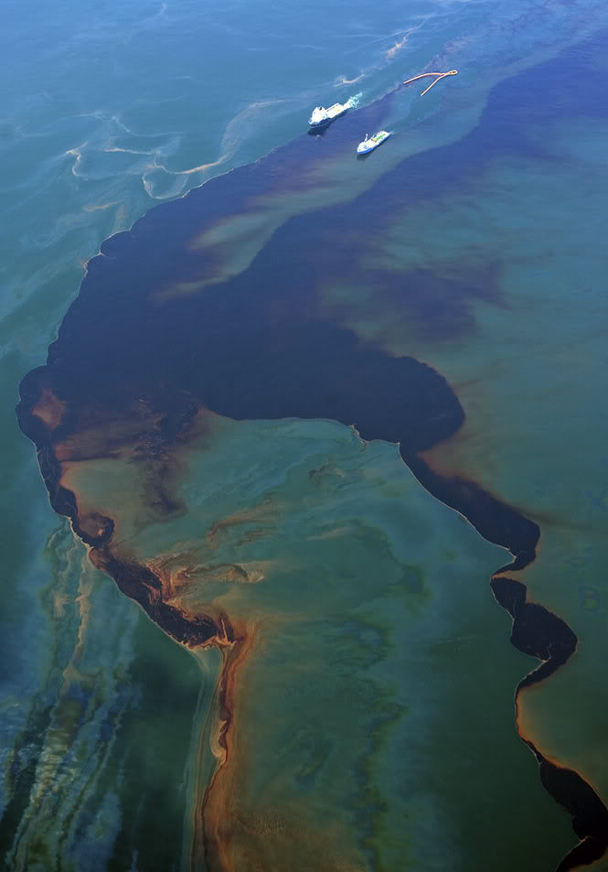
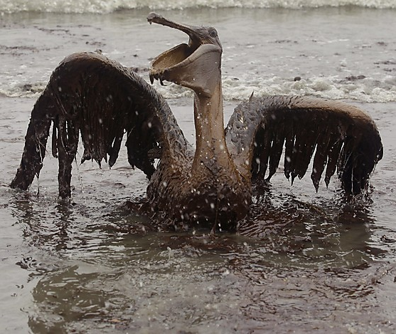
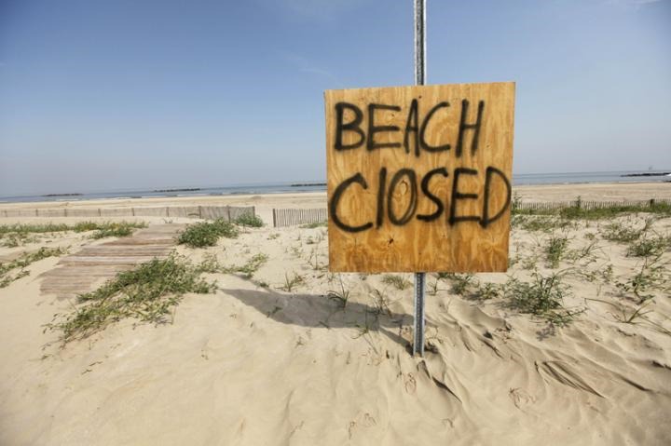
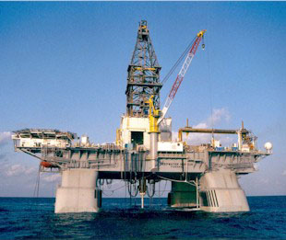
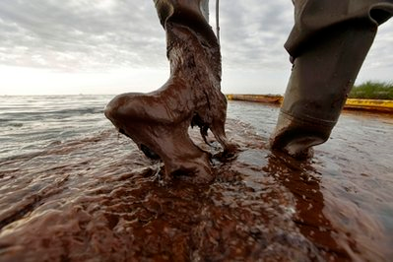
Deepwater Horizon
On April 20, 2010, an explosion occurred on the British Petroleum operated Deepwater Horizon drilling platform situated about 40 miles from the coast of Louisiana.
On July 15, 2010, a temporary stop to the oil spill occurred with the placement of a cap. Relief wells are currently underway to provide a permanent cease to the flow.
Notes:
Most if not all have some inclination as to the series of events that led to the Deepwater Horizon incident. However for those who do not the event began when on April 20, 2010, and explosion ripped though the British Petroleum operated Deepwater Horizon drilling platform about 40 miles off the coast of Louisiana. On April 22, 2010, as a result of the explosion, the platform sank, and an open wellhead below the oceans surface continued to spew oil into the Gulf at an unknown rate for nearly three months.
As those three months passed beaches along the coast slowly closed and tar balls appear inland……communities were hindered with a lack of tourism, the GULF commercial fishing industry was halted and an unprecedented amount of oil was released into the ocean.
As it pertains to the amounts of oil released….I am actually a little weary about giving numerical estimates because the numbers vary so greatly but it was noted that number far exceeded the million gallon mark and that the spill is single contributing factor to the largest ecological disaster in United State History.
On July 15, 2010 a temporary cap was placed on the open wellhead which significantly impacted the rate of the spill, however currently a more permanent solution is being sought out with relief wells being drilled and expected completion date sometime within the current month.

Slide 4
Objective
Through the development of a spatial application, an assessment using GIS was made to view the extents of the 2010 Deepwater Horizon oil spill. Key components found within the application include:
NOAA National Marine Sanctuaries
Fishery Closures
Oil Extents
Deepwater Horizon incident
Vessel Monitoring System Data
Shoreline
Notes:
So through the development of a spatial application, an assessment using GIS to view the oil extents of the 2010 Deepwater Horizon Oil spill was my overall objective. Some of the Key components found within my assessment included:
NOAA National Marine Sanctuaries, deep sea corals, Fishery Closures, Vessel Monitoring System Data, Shoreline data of coastal states directly situated within the Gulf, the location of the Deepwater Horizon Incident, and of course Oil Extents!

Slide 5
Environmental Factors
Deep Sea Corals
Found at depths just beneath the surface to the abyss (2000 m), where water temperatures may be as cold as 4° C
Lophelia & Oculina
extensive deep-water communities that attract commercially important species of fish, making them susceptible to destructive bottom trawling practices
NOAA National Marine Sanctuaries
Florida Keys National Marine Sanctuary
Flower Garden Bank National Marine Sanctuary
Notes:
More in depth…the environmental factors viewed within the application included Deep Sea Coral Communities, and the two NOAA national marine sanctuaries located in the Gulf of Mexico.
A topic emerging study deep sea corals are viewed as vital components of our ecosystem. Like shallow water corals they provide crucial habitat and reproductive grounds for commercially important fisheries, are highly diverse, important to the protection of shorelines as well as of great economic value.
The two most noted species of deep sea coral include the Lophelia and Oculina species.
Thus they are found in both The Florida Keys and Flower Garden Banks National Marine Sanctuaries.

Slide 6
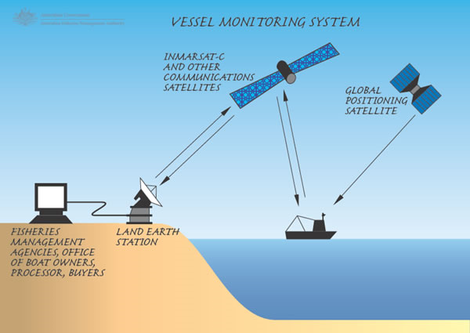
Vessel Monitoring System
The Vessel Monitoring System is an expansive system regulated by the NMFS Office of Law Enforcement
Information that can be found within the VMS database includes, USCG radio number, vessel name position, and average speed
Notes:
The VMS is an expansive system regulated by the NFMS OLE…….. and here I made available and actual visual representation on how the system works…….Information within the database in confidential and includes information pertaining to USCG radio number, vessel name, position via lat and long coordinates, id, and speed.
Information for the VMS is again stored in an expansive database and was manipulated into a usable form in order to produce the developed assessment.

Slide 7
Methodology
Data Sources
National Oceanic and Atmospheric Administration
NMFS
Closures
Permitting data/Fishery Codes
Vessel Monitoring System (VMS)
Benthic Specified Fisheries
Roffer's Ocean Fishing Forecasting Service, Inc.
a scientific consulting company based in Miami and West Melbourne, Florida (U.S.A.) that is involved with fisheries oceanography, environmental science, and satellite remote sensing.
Software
ESRI® ArcMap™ 9.3.1
Oracle 11g SQL Developer
Microsoft Access 2003
Notes:
Data sources for all information found within this presentation were retrieved from either one of two sources. Those sources included either ROFFS, an independent scientific consulting company whom provided all oil extent imagery, ….. or NOAA whom provided all remaining………the software utilized included ArcMap, Oracle SQL Developer, and Microsoft Access. Most data provided was already in usable they were to made part of the assessment.
ROFF images initially were provided in jpg format…..using arc map images were imported into the software, georeferenced using three constant point of latitude and longitude, projected, and displayed.
VMS data was store on a database and in order to retrieve an SQL query was developed to pull it from the server, exported into an excel document, aggregated by common fishery, and imported into ArcMap. From there that information was displayed via X and Y information, projected , and identified by properties concerning different fishery codes.

Slide 8
Study Area

Slide 9
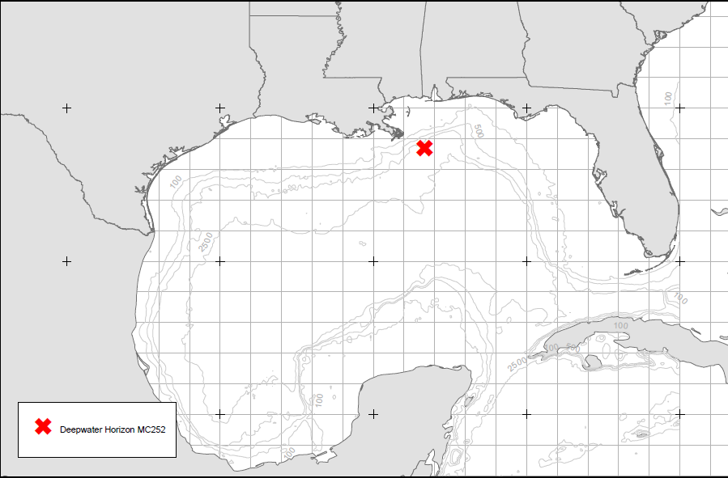

Slide 10
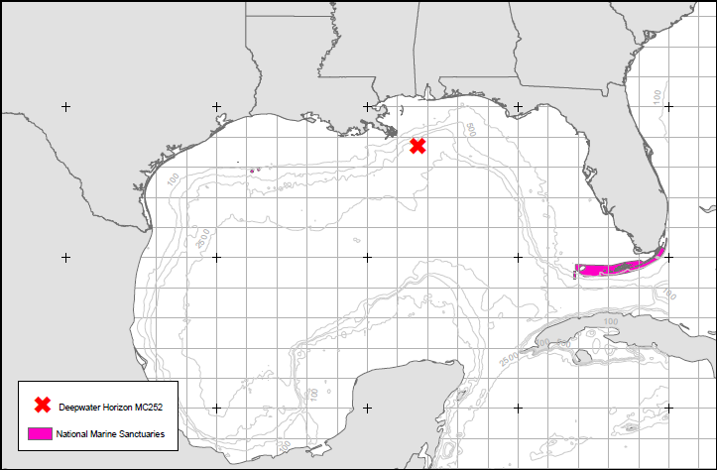

Slide 11
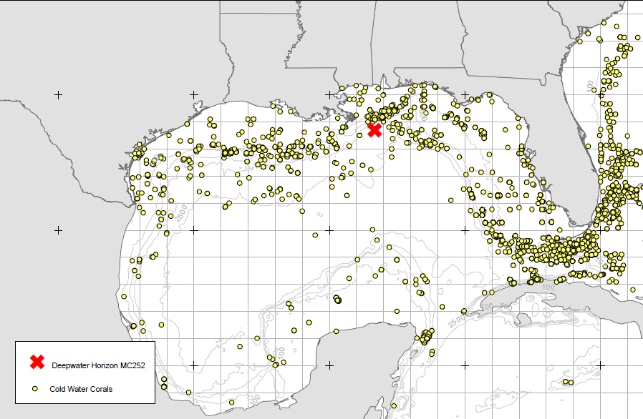

Slide 12
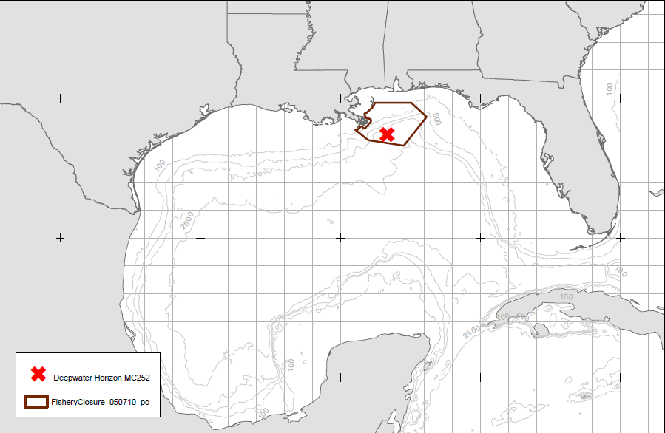

Slide 13
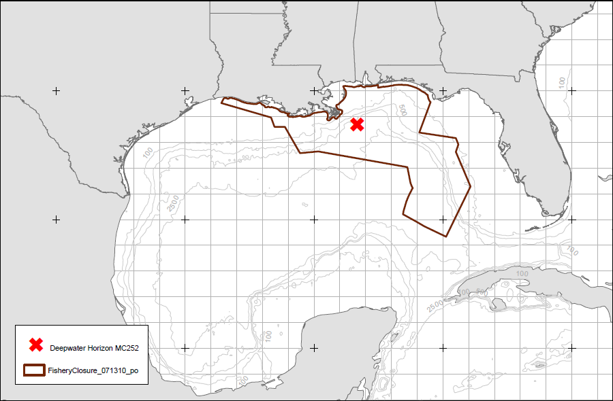

Slide 14
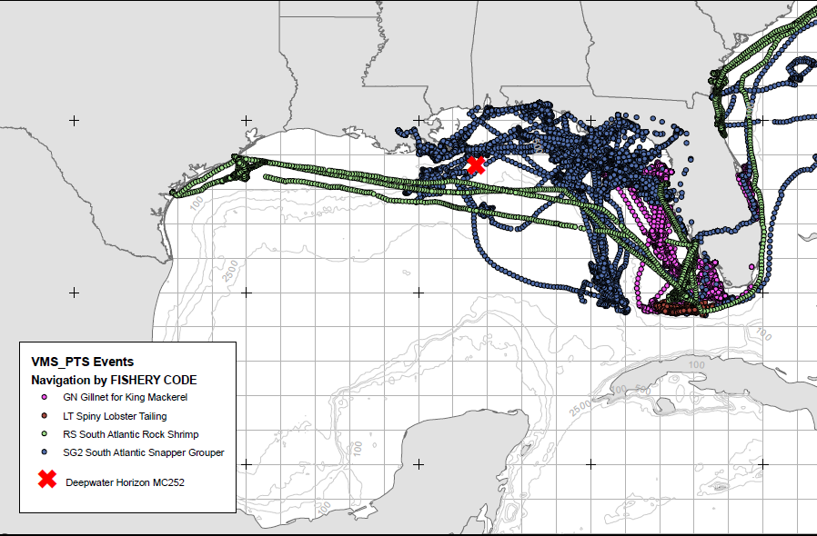

Slide 15
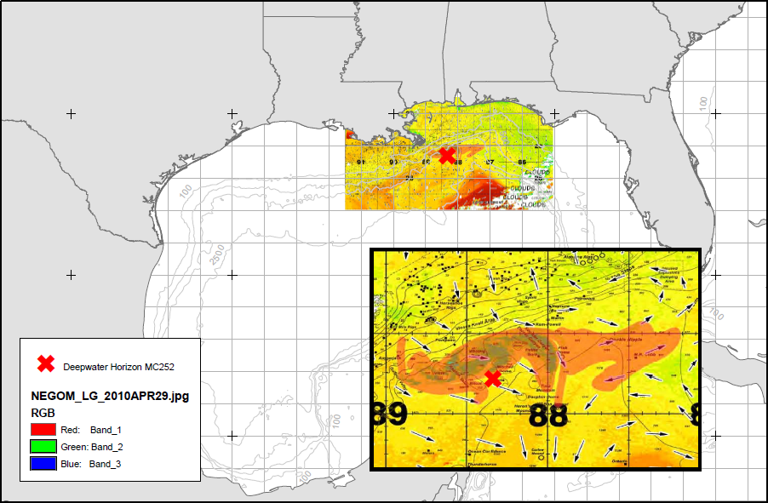

Slide 16
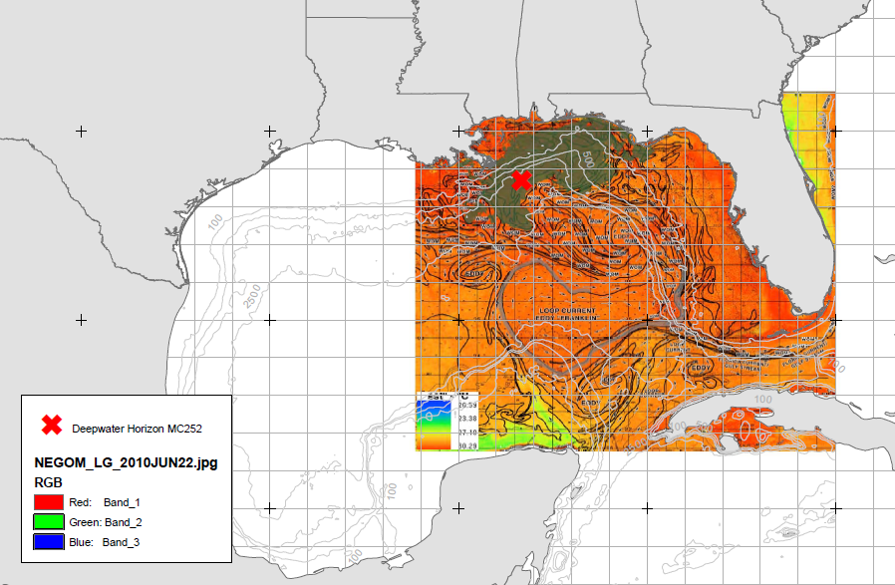

Slide 17
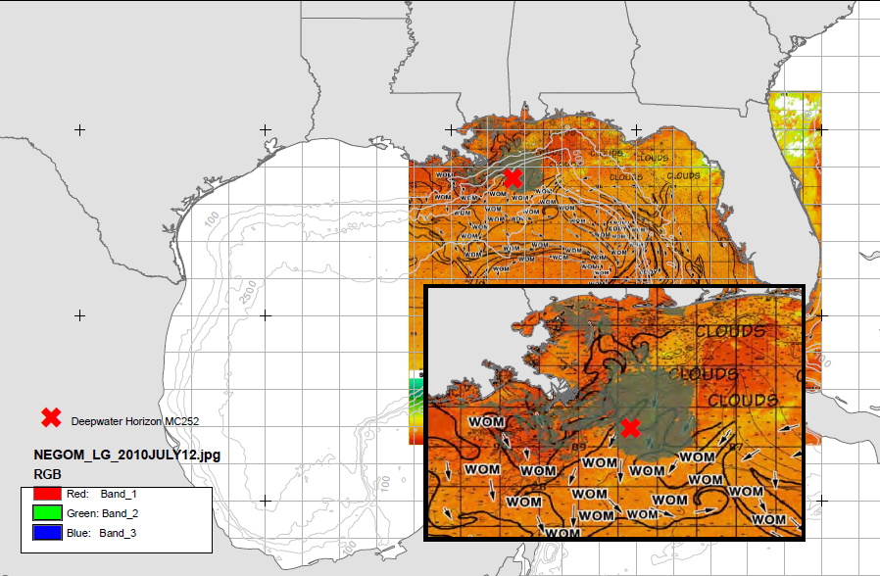

Slide 18
Conclusion
…A Lack of access to recent permitting information within PIMS prevented a comparison of the most current fishing data with previous years. However, assuming that fishing activity is spatially static from year to year, we were able to identify the overlap between last years fishing activities and this years oil spill extent…
Notes:
A Lack of access to the most recent permitting information within PIMS prevented a comparison of the most current fishing data with previous years. This occurred because information directly for the months following February 2010 was unable to identified and only information for preceding months of 2008-2009 permits was able to be displayed However, assuming that fishing activity is spatially static from year to year, we were able to identify the overlap between last years fishing activities and this years oil spill extent by viewing both the current clousure and VMS data simultaneously.

Slide 19
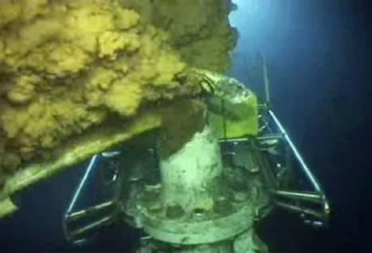
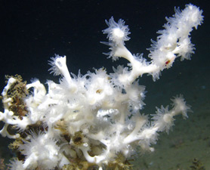
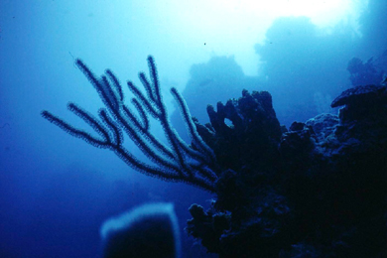
Future Applications
Oil Extents
VMS data
Export/Import
Current fishery data
Statistical Analysis
At Risk Coral Communities
Yearly Assesment
Notes:
At the current moment its kind of difficult to impliment furture studies of this project because it is current and ongoing. However within Miami’s South East Fisheries Science center oil extents continue to be provided on a weekly basis, VMS data is still being retrieved from the data base.

Slide 20
Acknowledgements
Carlos Rivero and Southeast Fisheries Science Center Cooperating Agencies & Individuals NOAA Office of Education
Notes:
I would like to acknowledge the SEFSC for my summer experience as we as cooperating agencies and individual. I would also like to think NOAA’s office of Education, my NOAA EPP Family, Sarah, Debie, Jamaris, Angelica, Rosimar Wilsharo Lorielle, and a special hollings student Chelsea…as well all my officemates from the summer for providing me with a wonderful year two years.

Slide 21
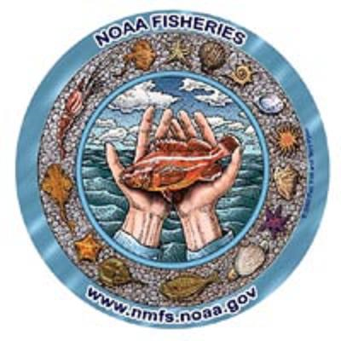
Questions patrina.bly@noaa.gov
Notes:
Questions!

